Slide 1

Mkt530 Module 2:
Reporting Research Results
Ch 23 (in recent editions)
Finding and Reporting with Secondary Data
Ch 4

Slide 2
No matter what kind of job you get …
Marketing Research
Marketing Strategy
Professional Sales
Digital / Social Media Marketing
Brand Management
Consulting
Non-marketing

Slide 3
An important part of your jobs…
… is probably going to involve writing up results of something … research reports, product briefs, sales proposals, results of campaigns, activity summaries, or something similar
Report write-ups typically have a very specific format, either for a client or for internal use

Slide 4
Keys to all report-writing:

Slide 5
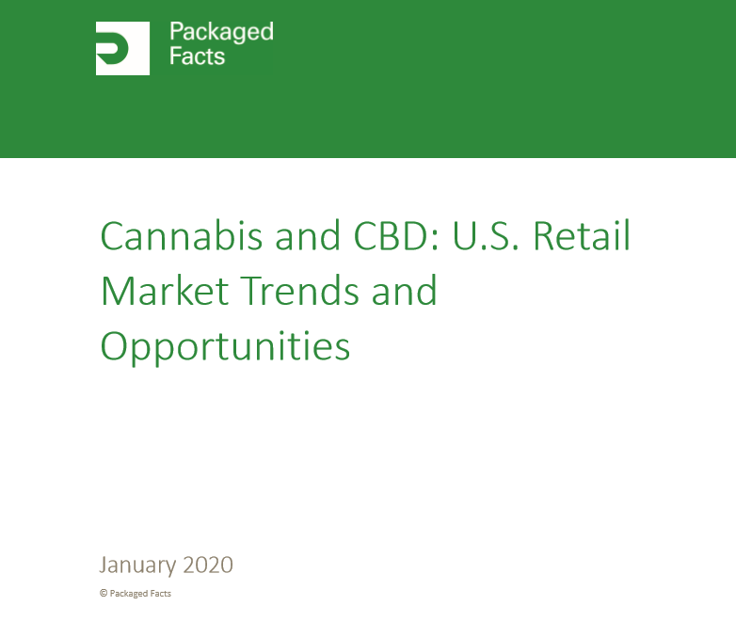
A Clean Cover - always
Not much of a graphic
Title, Graphic, Researcher(s), Date

Slide 6

Title, Graphic, Researcher(s), Date
I like a more interesting graphic on the cover …

Slide 7

Title, Graphic, Researcher(s), Date

Slide 8

Title, Graphic, Researcher(s), Date

Slide 9

Effective?
Distracting?

Slide 10
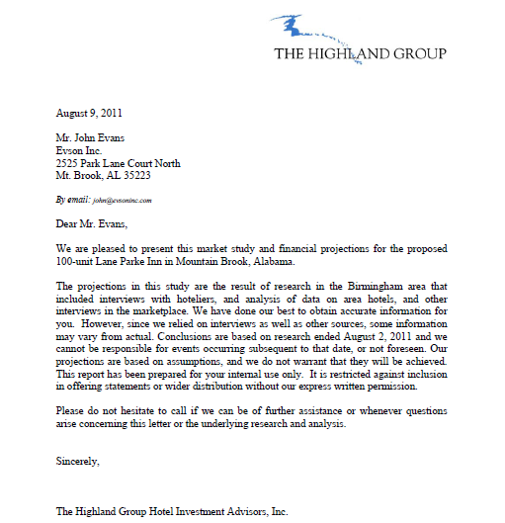
A Letter of Transmittal - Often
Especially a report for a client

Slide 11
Executive Summary – For a long report
The Executive Summary taps into each of the major findings that are detailed later in the report
Typically bullet form (but not always)
Succinct and to the point
Summary of final findings and recommendation either at end or at beginning of executive summary

Slide 12


Slide 13

Also effective …

Slide 14
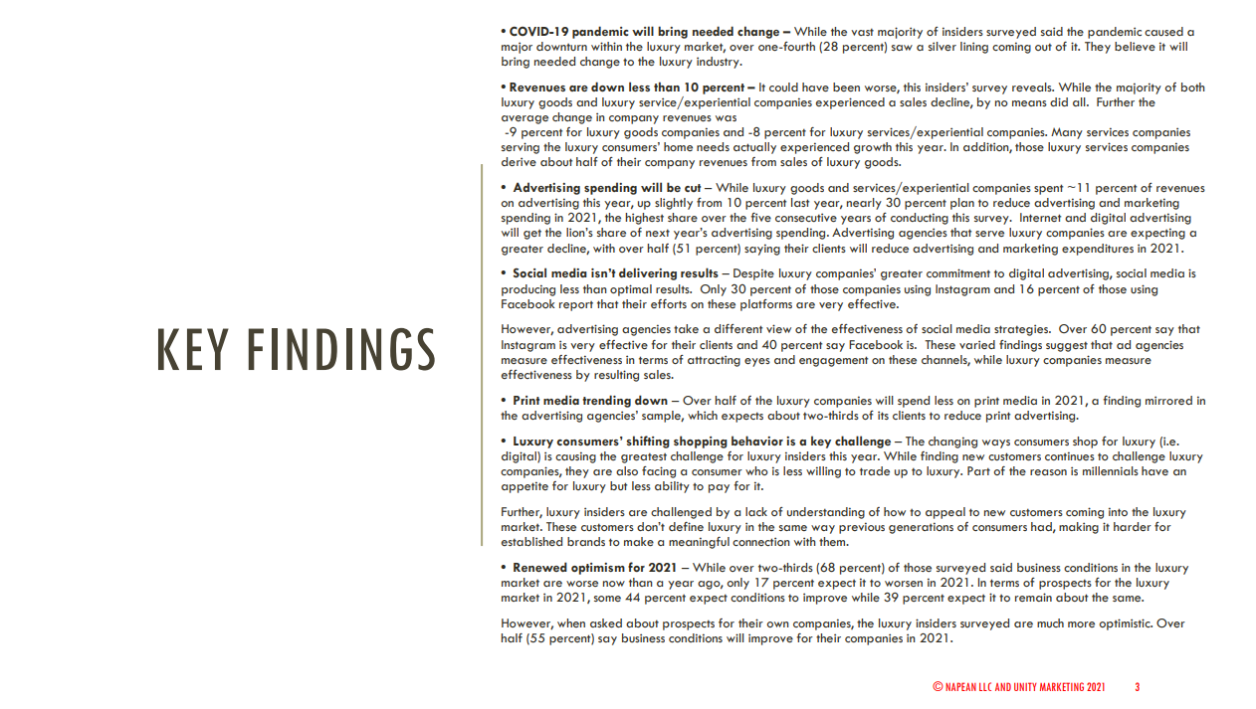
Continued …
Highlights Continued

Slide 15
Body of the Report: Using text to refer to Tables, Maps, and Graphs

Slide 16
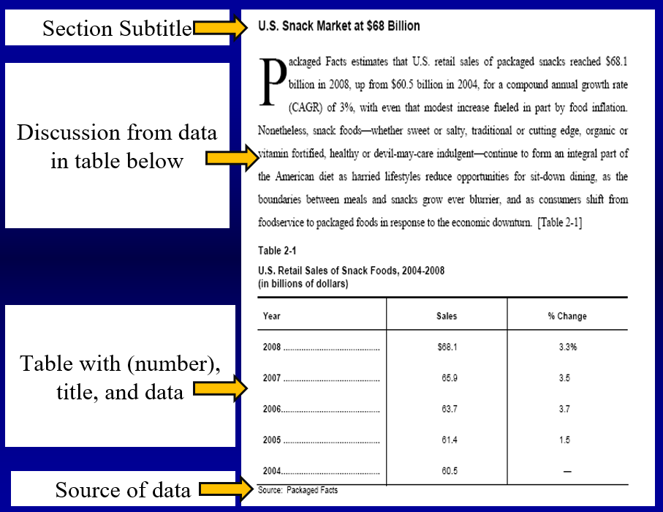
Always the same rules:

Slide 17
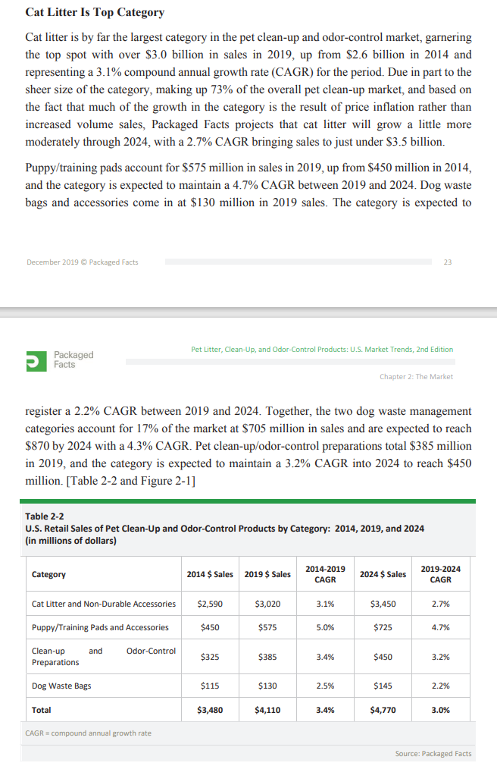
Subtitle
Discussion
From Table
Table
Source

Slide 18
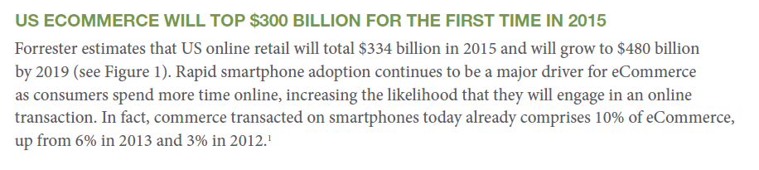
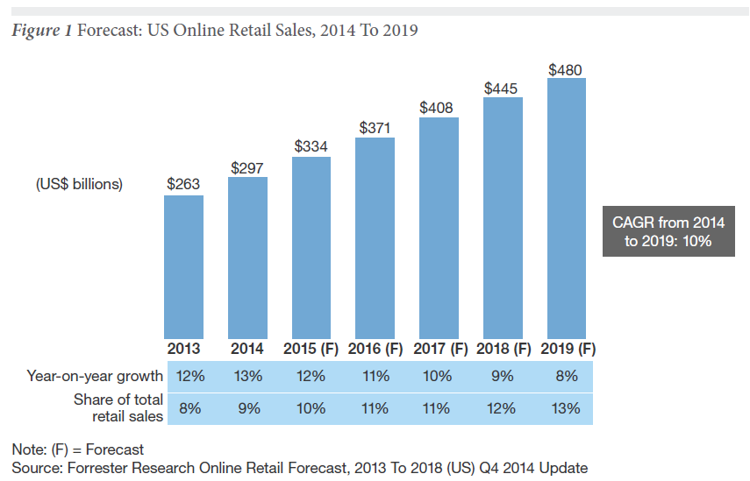

Slide 19
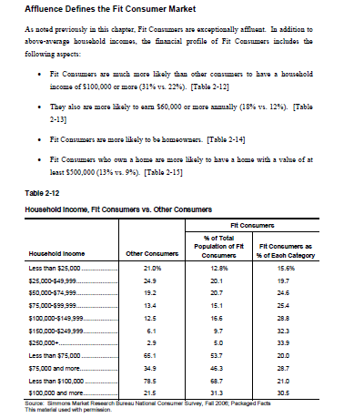

Slide 20
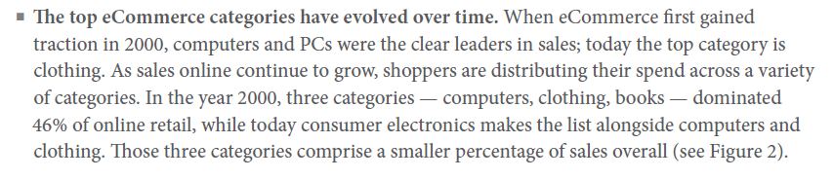
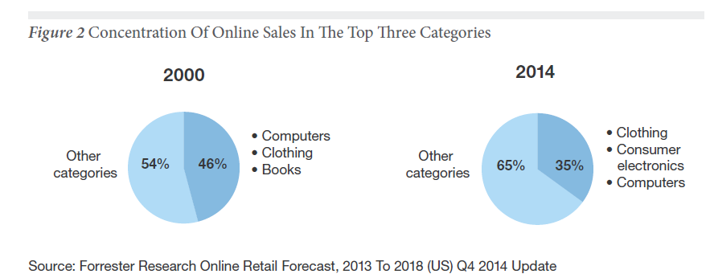

Slide 21
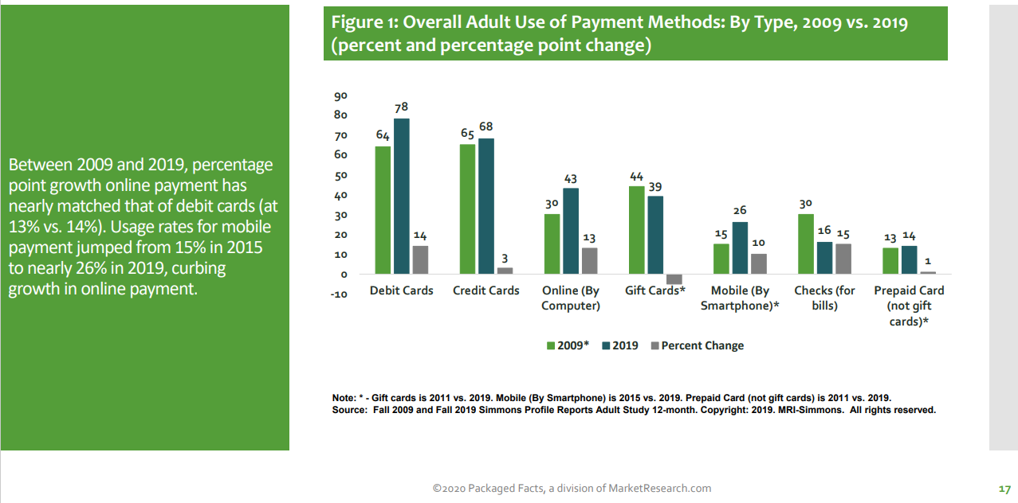
New Packaged Facts Format
Also ok … but needs subheading

Slide 22
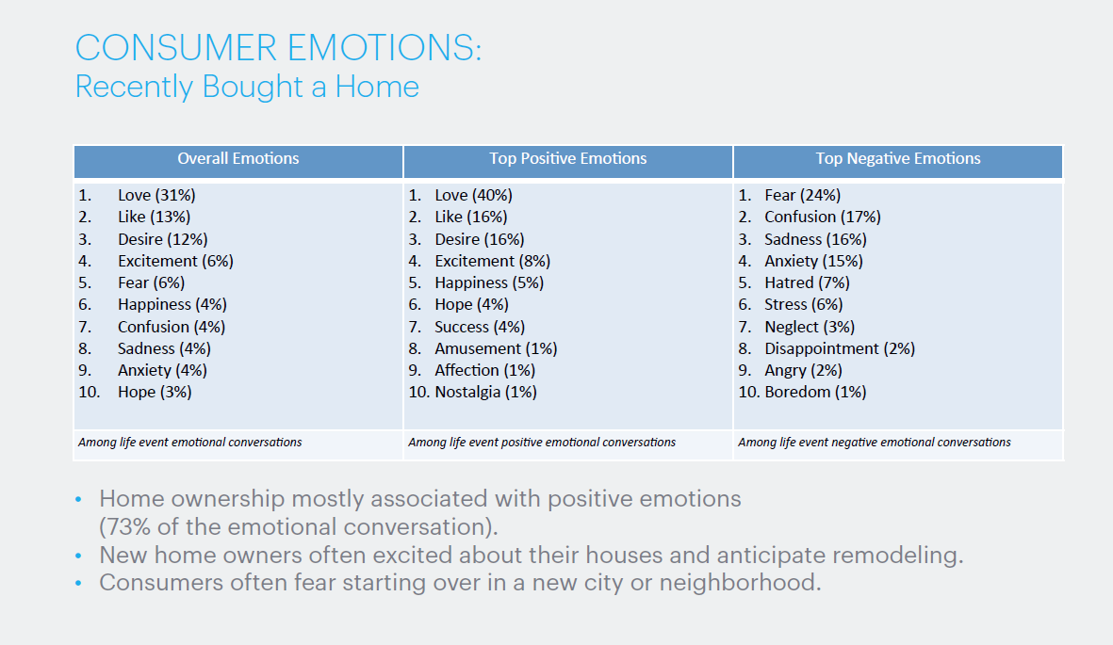
Wrong

Slide 23
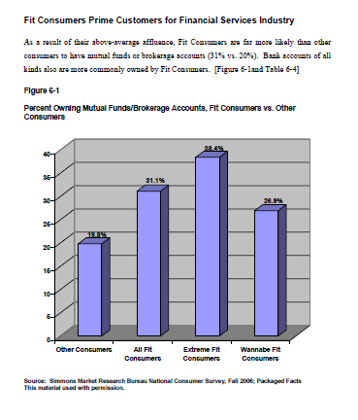
Charts are cooler than most tables

Slide 24
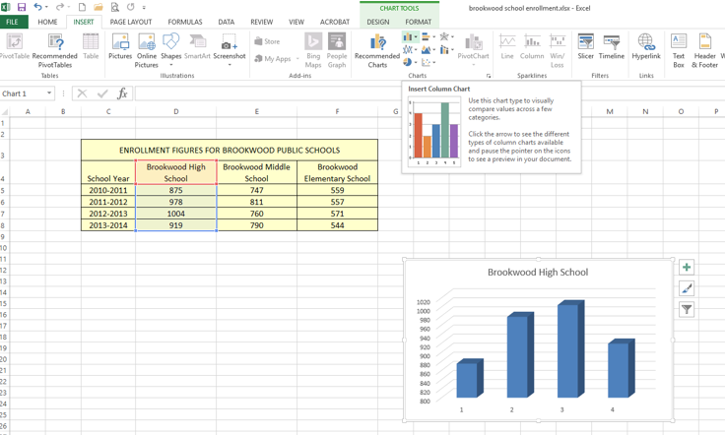
It takes 10 seconds to make a chart

Slide 25
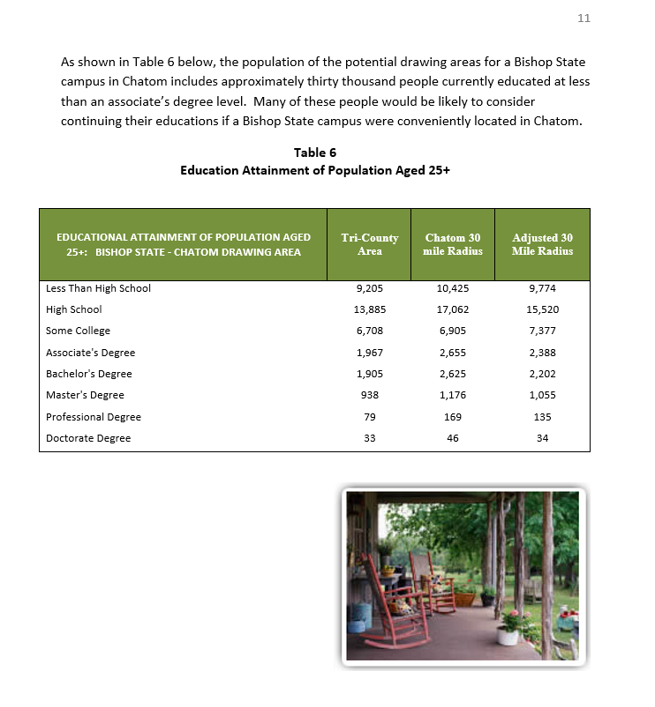
Pictures can “accessorize” boring tables

Slide 26
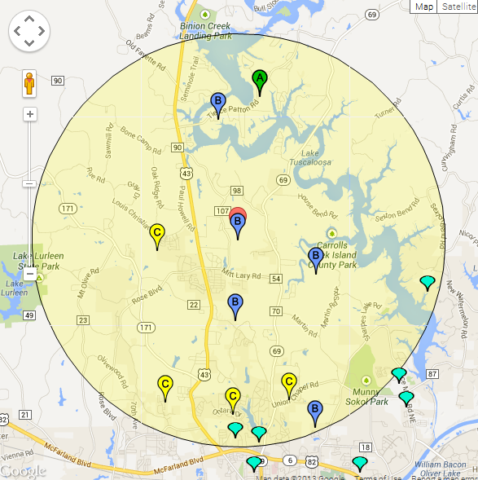
Once you put a map or chart into PowerPoint you can add lots to it
Hi, Mom!!
Best Site

Slide 27
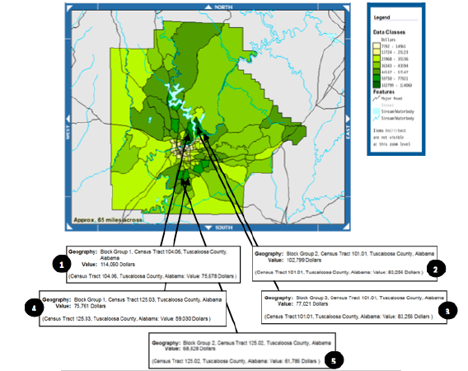
Snips and Screen captures make great slides

Slide 28
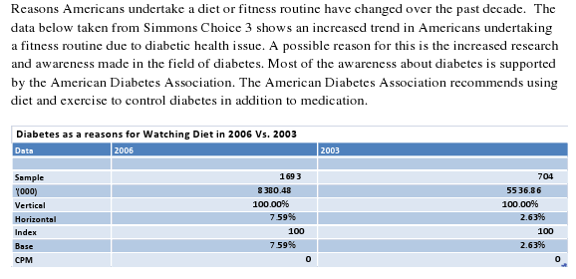
But only leave in a table what you are going to use …
Meaningful data??

Slide 29
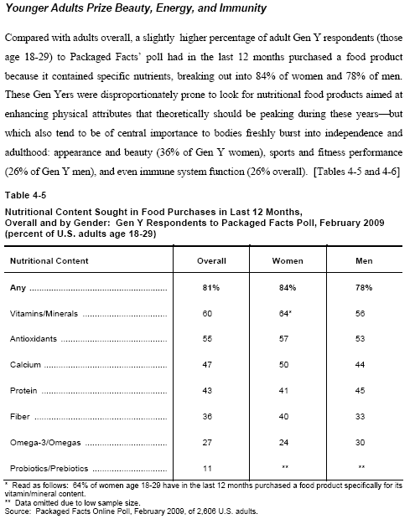
Reporting survey results
Percents only … not sample numbers !

Slide 30
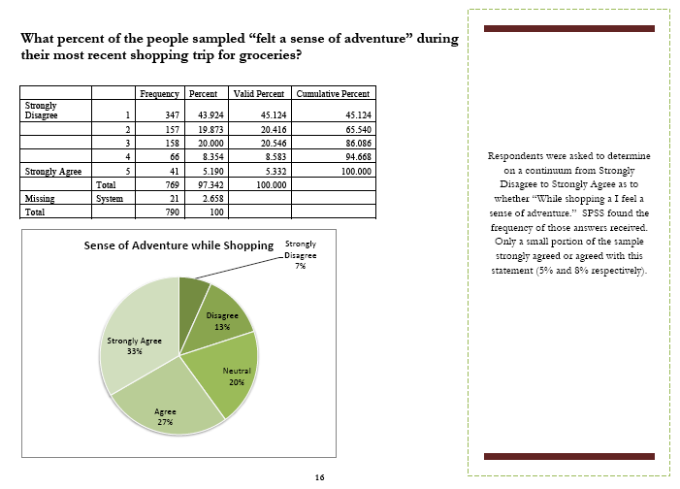
Reporting survey results
NO
NO
NO
Edit your columns

Slide 31
Keys
Clean with white space.
Subheading, paragraph, then table/graph and source
Paragraphs - use of some specific numbers from the tables, maps, graphs but not overwhelming
No more than 3 to 4 sentences in a paragraph!
Succinct but long enough to explain what the tables etc “tell us” beyond just the numbers.

Slide 32
Using Secondary Data to create reports
Ch 4

Slide 33
Secondary data
Book definition: data that have already been collected for purposes other than the problem at hand
Our definition: Stuff we didn’t do but can look up or buy

Slide 34
For our purposes in MKT530
We are not talking about syndicated scanner data from Nielsen, etc.
We are not talking about our own data records
(although Malhotra includes them in this chapter)

Slide 35
Secondary data in marketing research
External secondary data search used to be a required step early in a marketing research project to just get basic figures and parameters to start the research. No longer -
1. Computer storage, 2. internet publishing and access, 3. Online data-for-profit service companies have changed all that.

Slide 36
A large percentage of marketing research reports rely only on secondary data
Secondary research is still exploratory research, but often is all that is needed for managerial decisions.

Slide 37
Types of projects where secondary data is very useful
Market potential / Industry analysis – overall and geographic
Market size (as part of opportunity analysis)
Competitive structure and competitor activities
Market dynamics and trends – change over time
Market segmentation … demographic, psychographic, geographic, product usage (but augmented with primary data?)
Location analysis and site selection (but augmented with primary data?)

Slide 38
Secondary Data can tell powerful stories
And very often are the first section in a report that also contains primary (survey) data

Slide 39
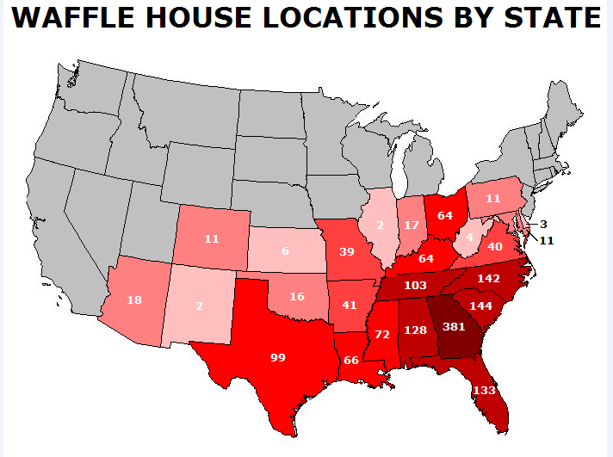
Telling stories with Secondary Data

Slide 40
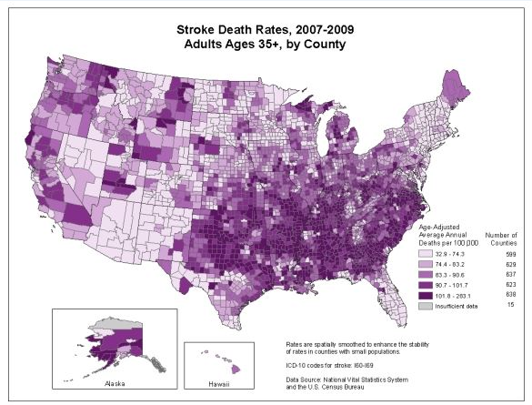

Slide 41
Relying on Secondary Data?
Privately versus government – generated
Scientifically generated versus non …
Age of data
Vested interest versus unbiased information provider

Slide 42

Vested Interest?

Slide 43
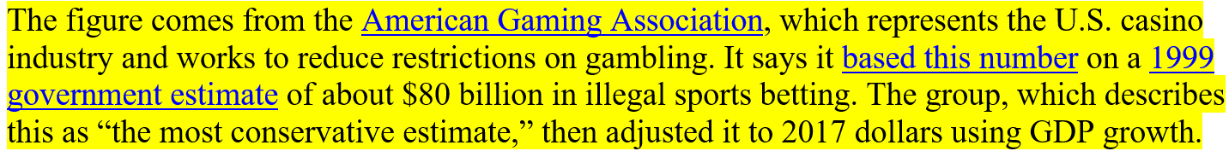
Market for illegal sports betting in US is not really a $150 billion business
The first thing you do in such cases is look for a real-world example. In this case, data from the U.K., which has allowed sports gambling for decades, with thousands of betting parlors offering odds on everything from Premier League matches to when royal babies are born.
The U.K.’s Gambling Commission tracks betting statistics and issues an annual report. The one released in January shows that Brits placed about 10 billion pounds in bets in the latest fiscal year.
To get a comparable estimate for the U.S., that figure needs to be adjusted by population and currency. The U.K. has only about 66 million people, compared with 327 million in the U.S. And the pound was worth $1.36 on May 14.
After making both adjustments, this suggests that if people in the U.S. are allowed to make bets at the same rate as in the U.K., the size of the industry would be about $67 billion a year. While enormous, that’s a far cry from $150 billion.

Slide 44
Secondary Information Types
Three basic types of secondary information we use:
General information, market size, market structure, economic issues, industry issues, industry trends, social trends, driving forces, characteristics of markets
Numbers, performance, locations, types of businesses (and other economic entities)
Numbers, behaviors, locations, types of people

Slide 45
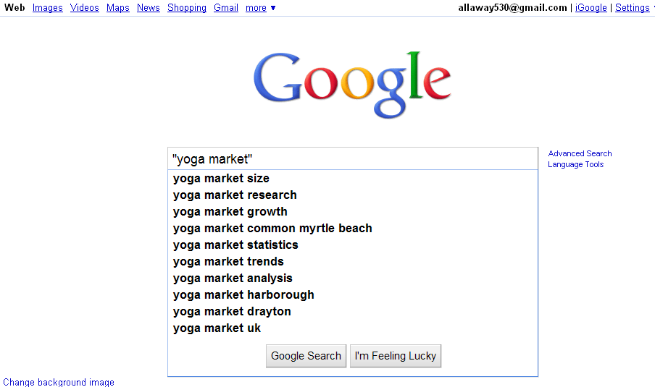
The obvious first step …

Slide 46
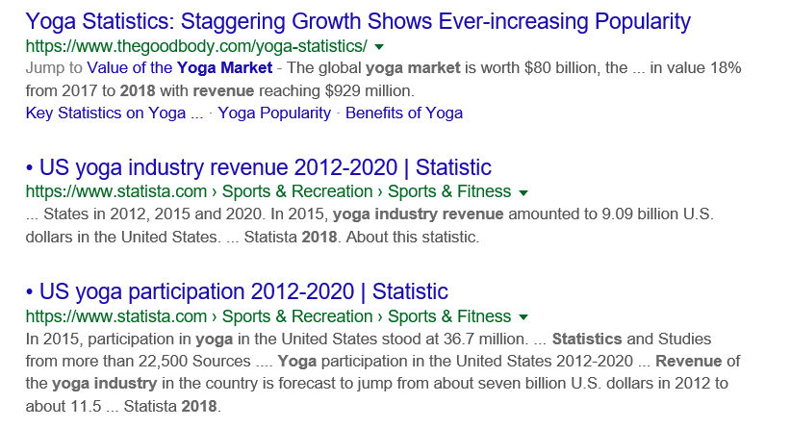

Slide 47
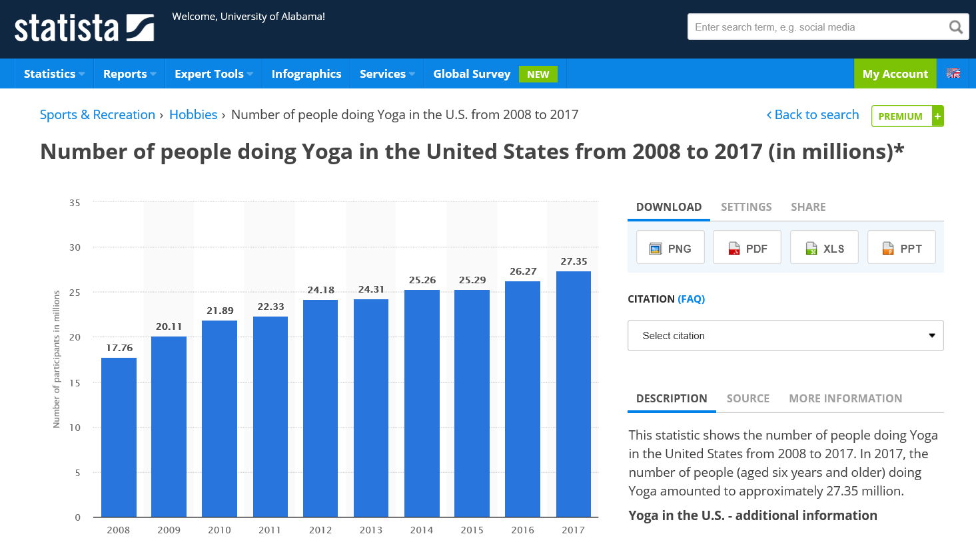

Slide 48
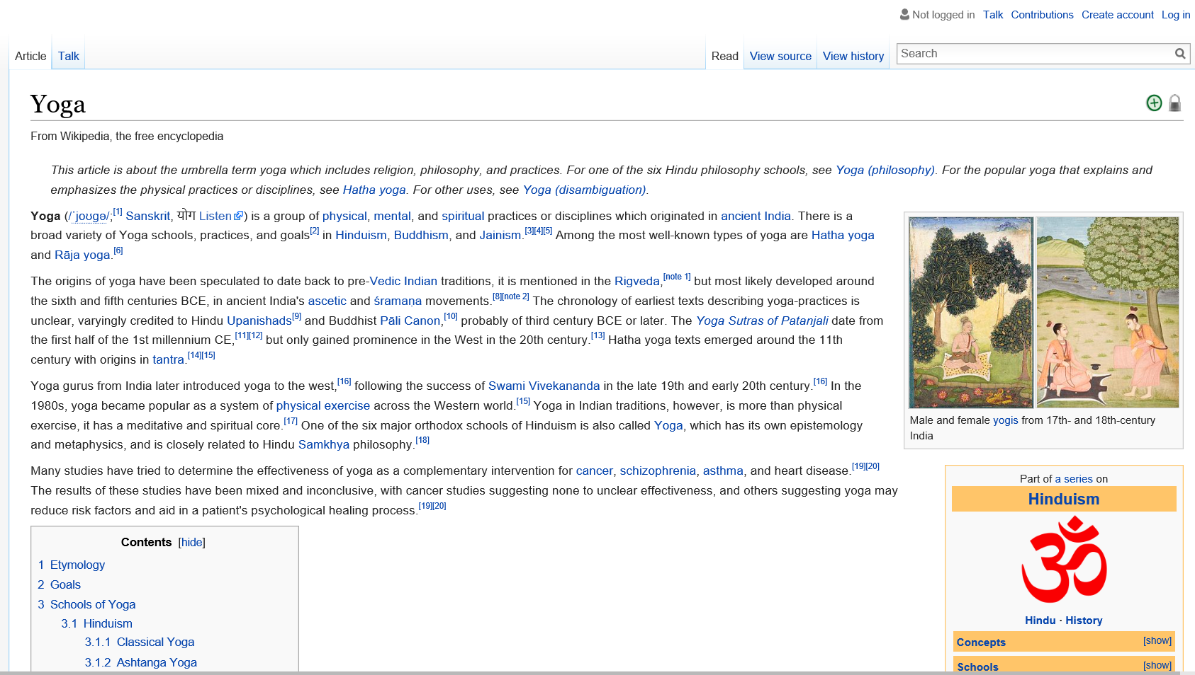
Wikipedia for background

Slide 49
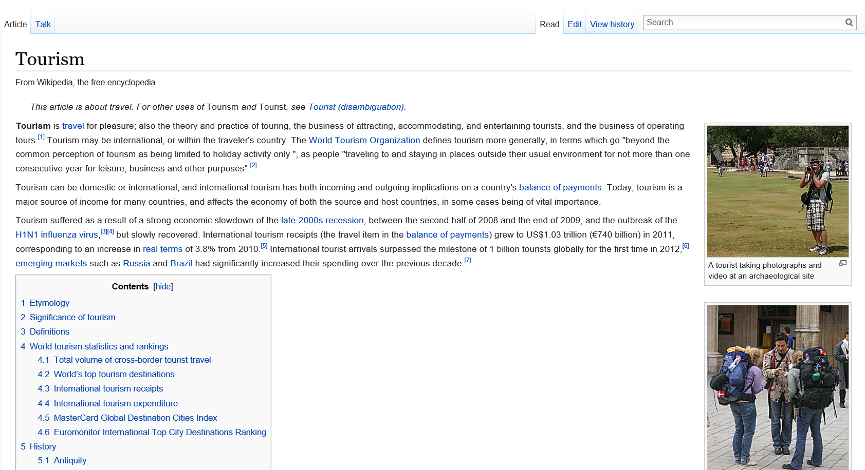
More Wikipedia

Slide 50
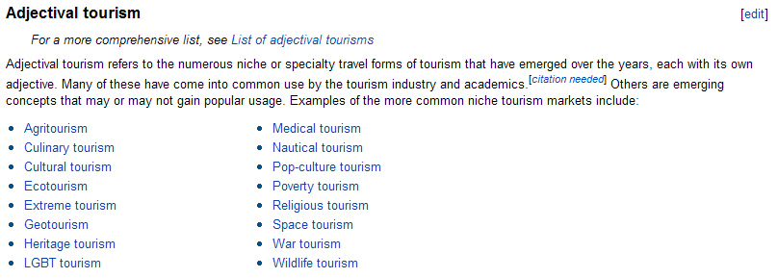
Wikipedia has great click-throughs

Slide 51
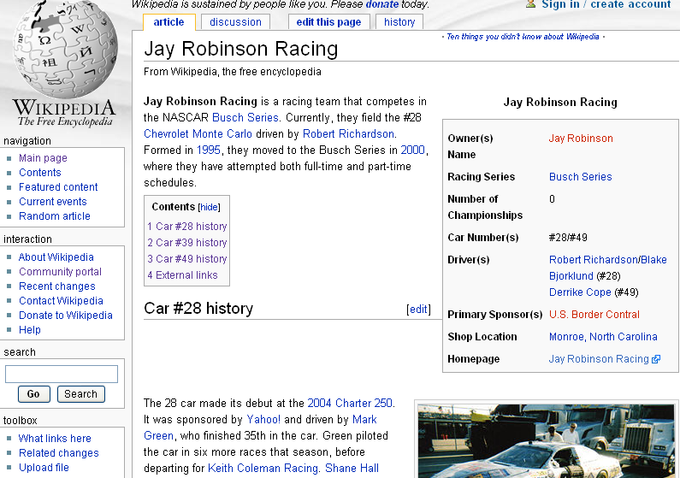
Wikipedia

Slide 52
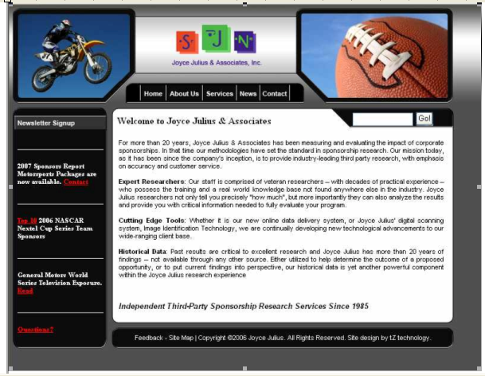
Click-through to …

Slide 53
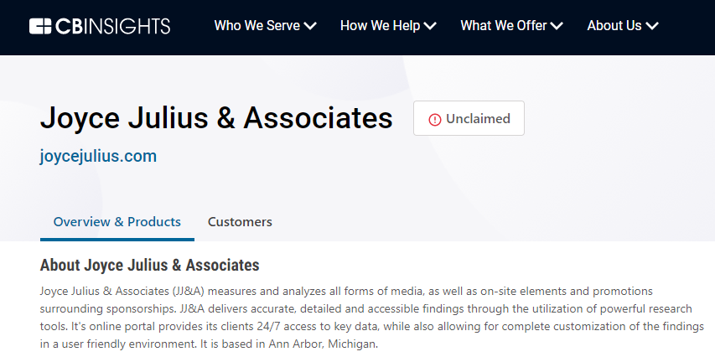
Which was recently bought …

Slide 54

New players …

Slide 55
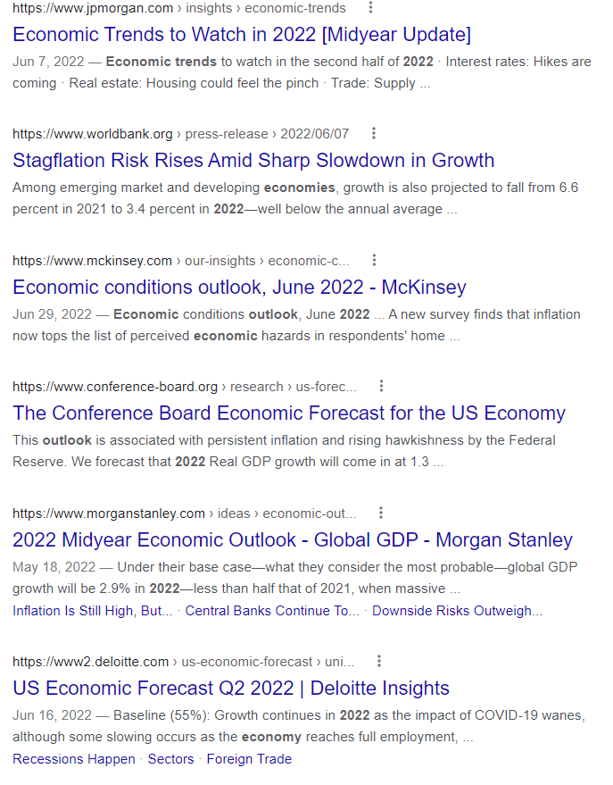

Trends

Slide 56
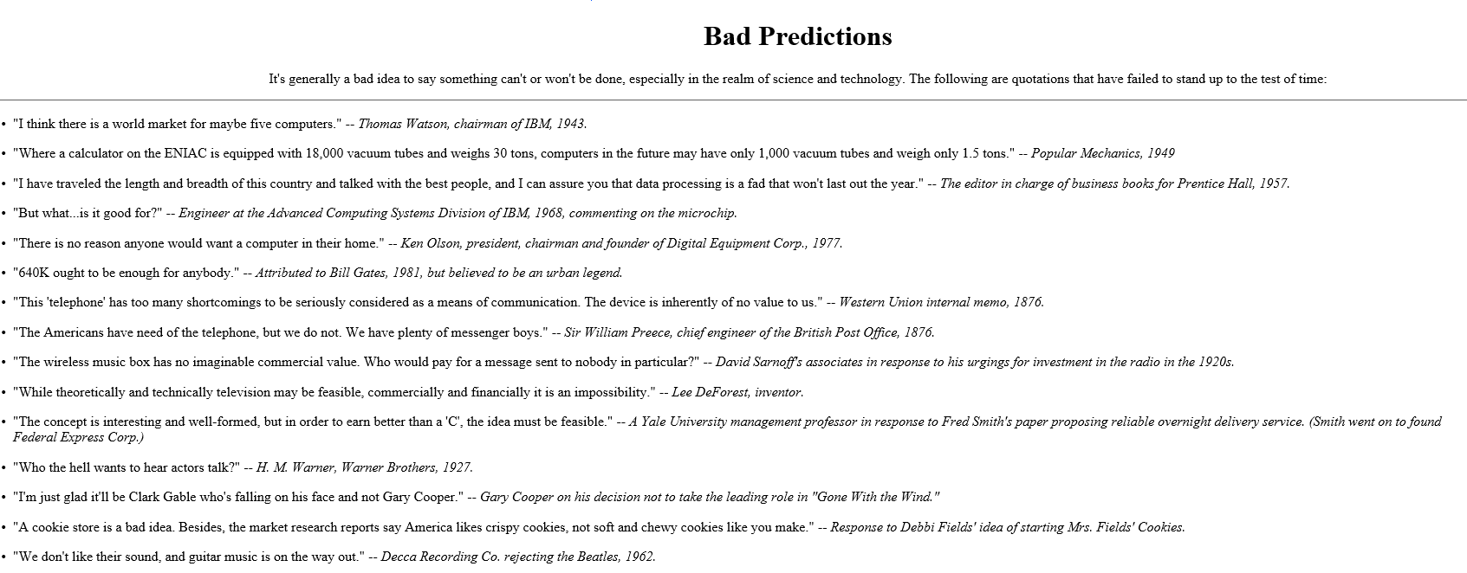
But …

Slide 57
Gathering “official” secondary data

Slide 58
https://www.richmondfed.org/~/media/richmondfedorg/research/national_economy/national_economic_indicators/pdf/all_charts.pdf
Current Economic Indicators

Slide 59
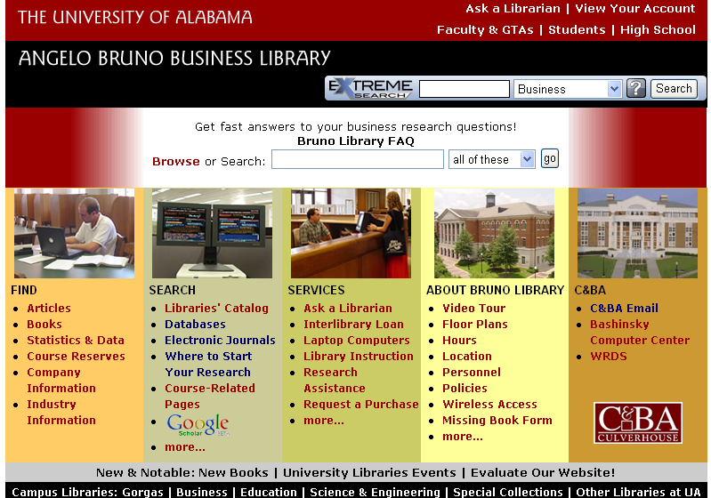
http://brunolib.cba.ua.edu/

Slide 60
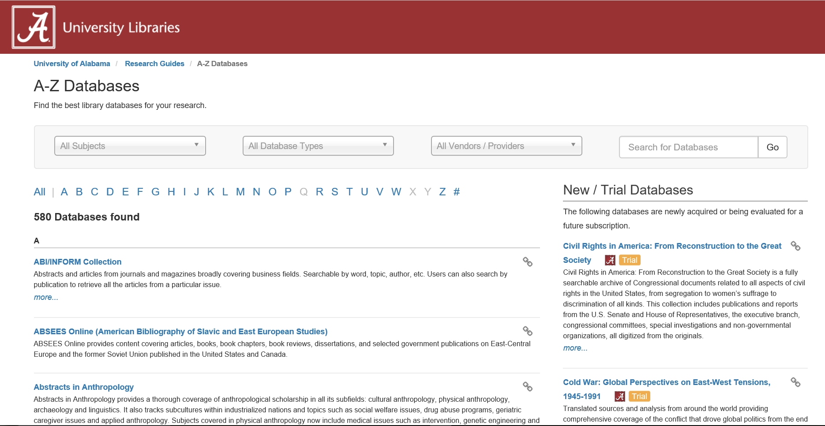

Slide 61
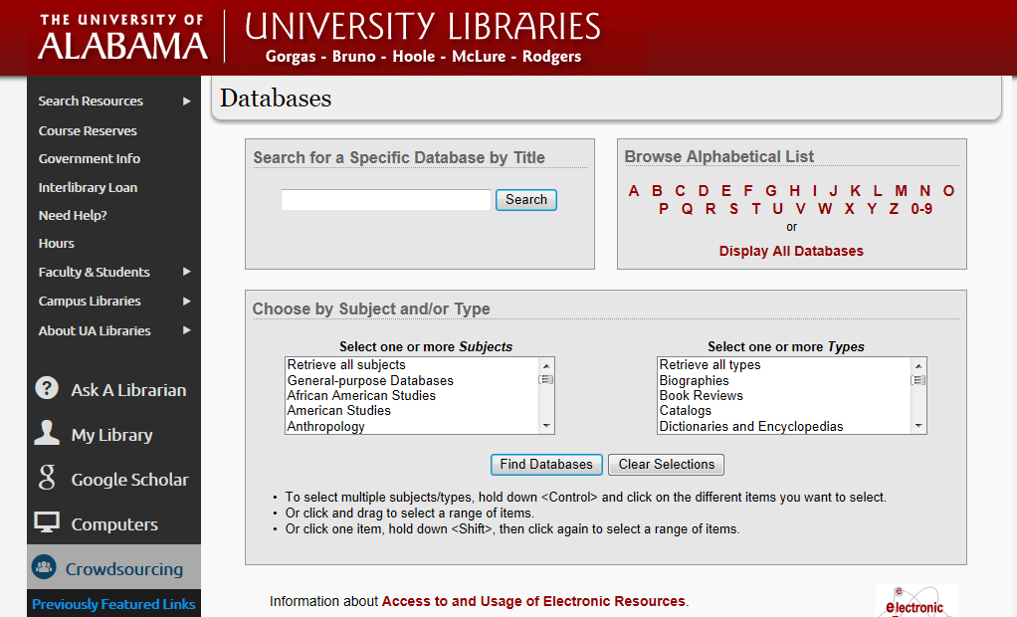

Slide 62

For Industry Reports by 5 Digit NAICS

Slide 63
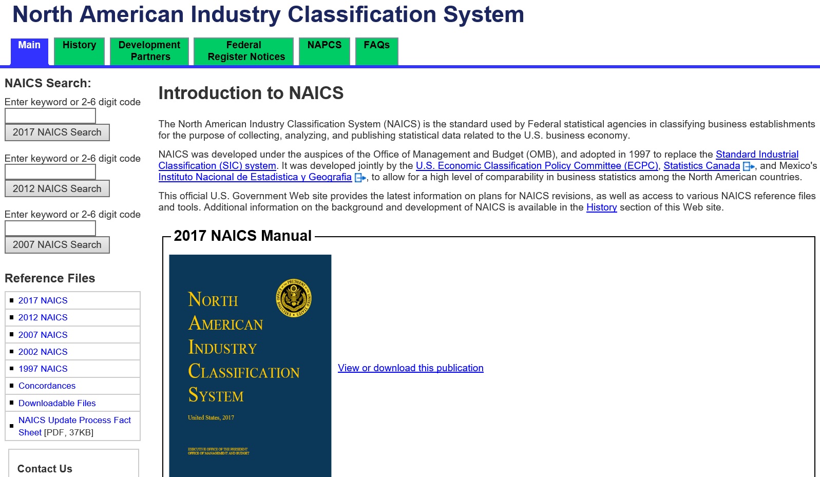
NAICS

Slide 64
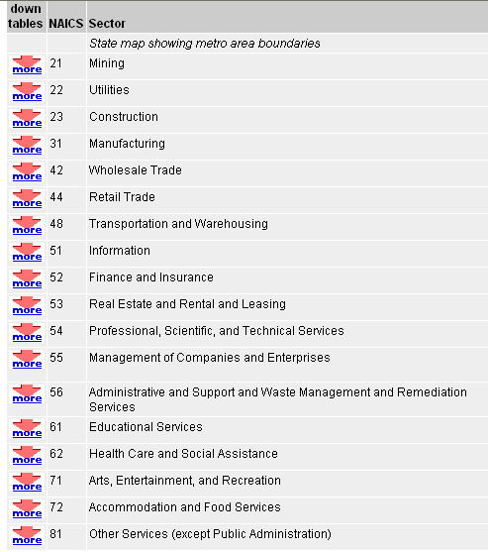
NAICS Codes (used to be SIC)

Slide 65
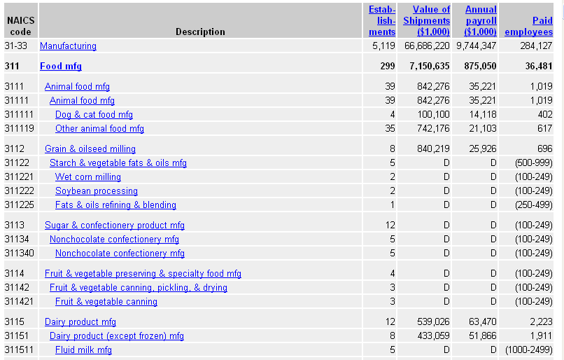
NAICS Code Details

Slide 66
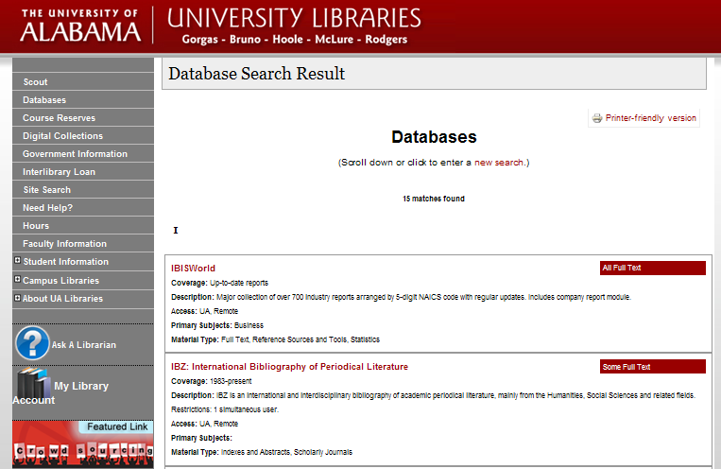

Slide 67
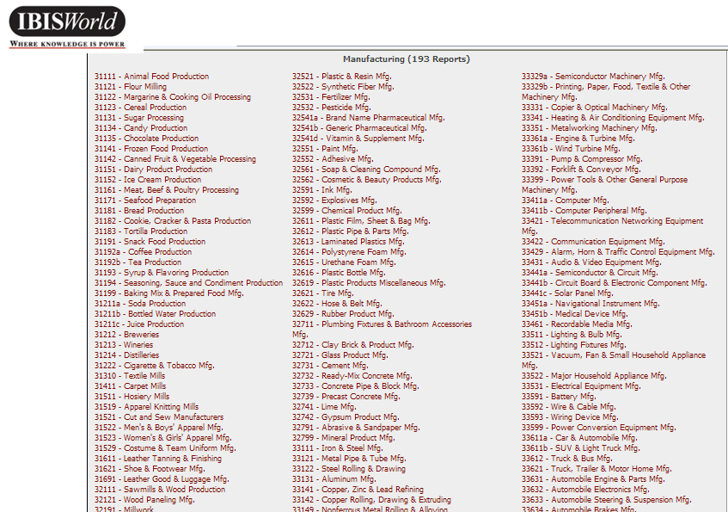

Slide 68
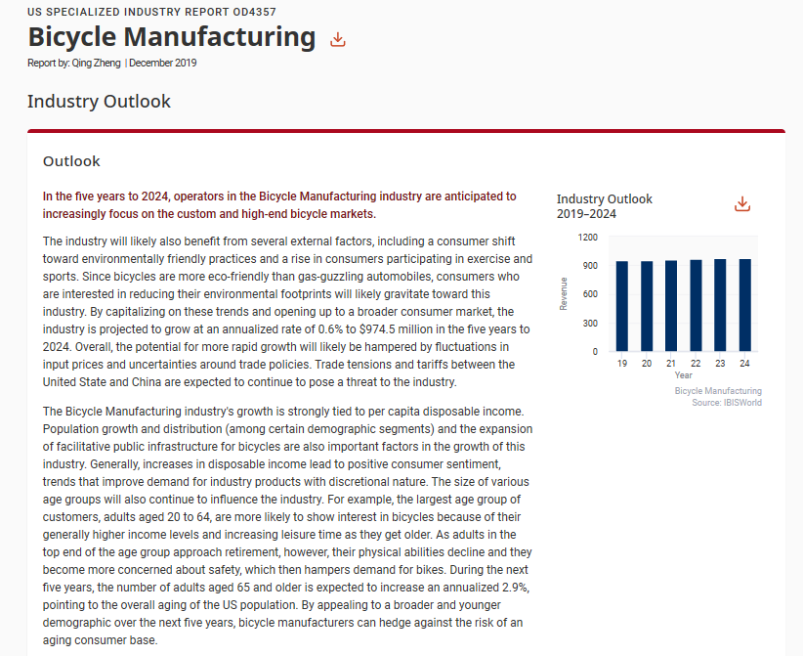

Slide 69
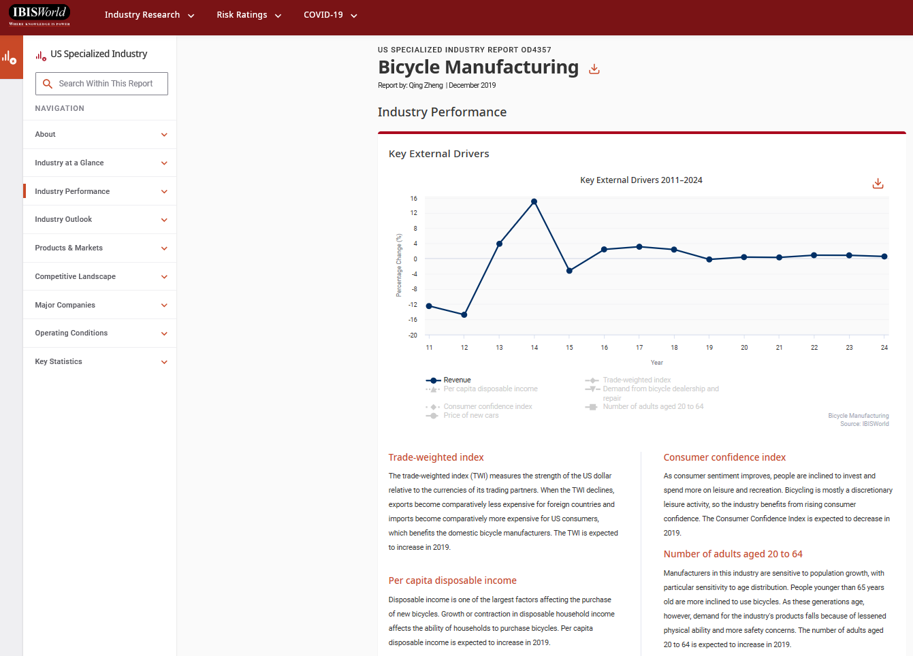

Slide 70
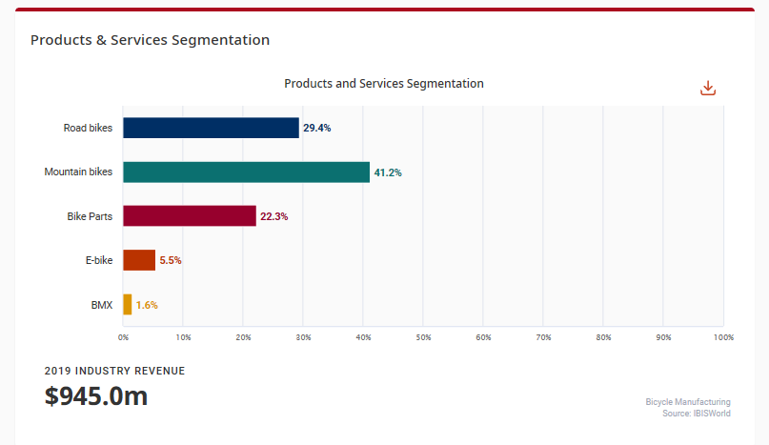

Slide 71
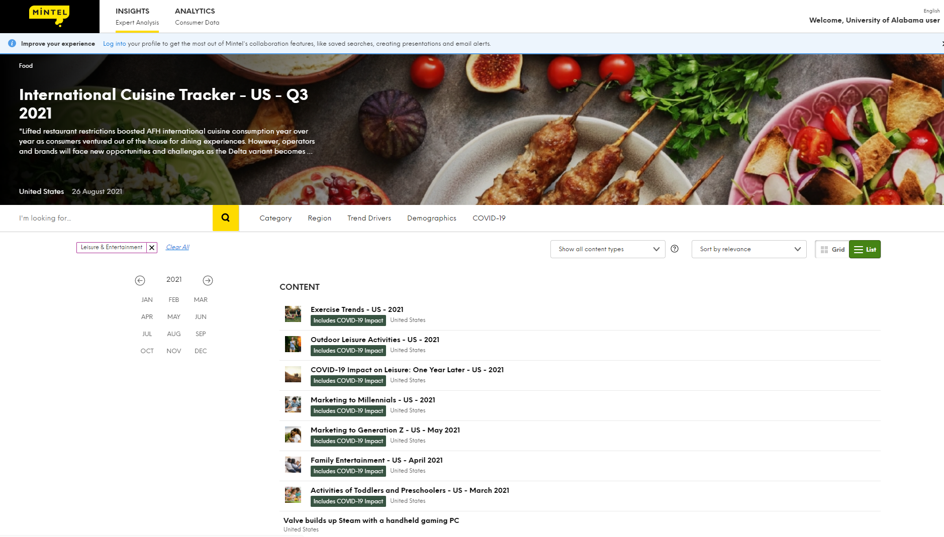
Mintel

Slide 72
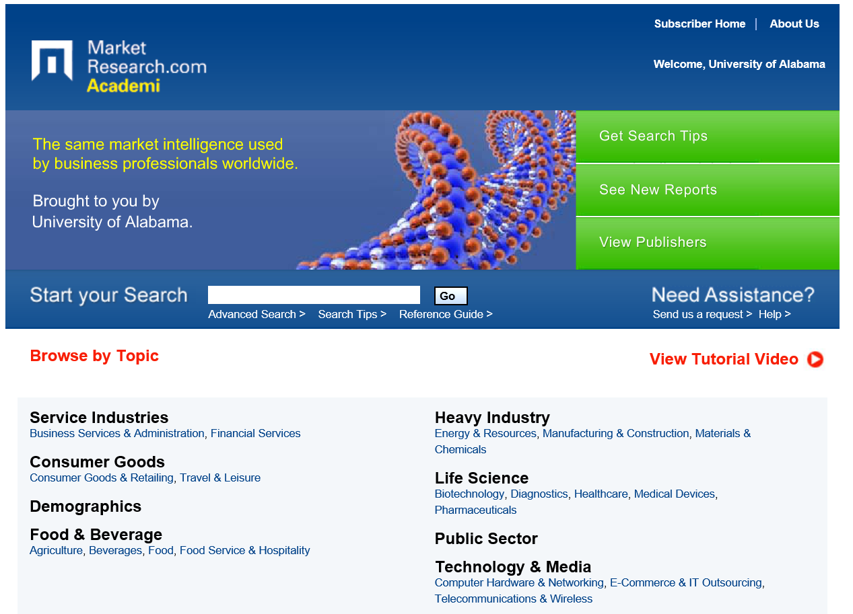
MarketResearch.com Academic

Slide 73
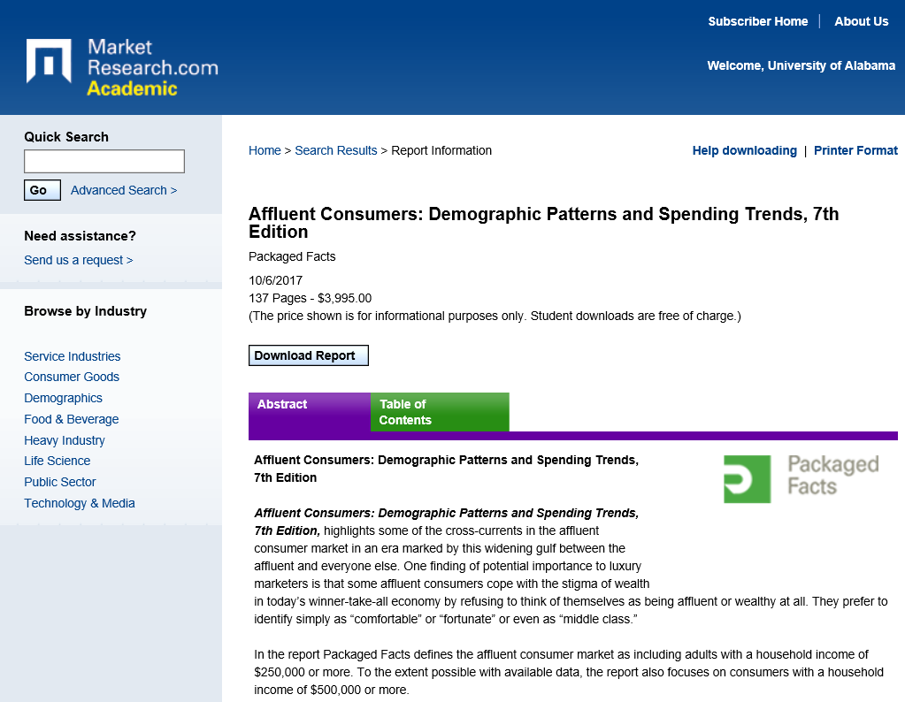

Slide 74
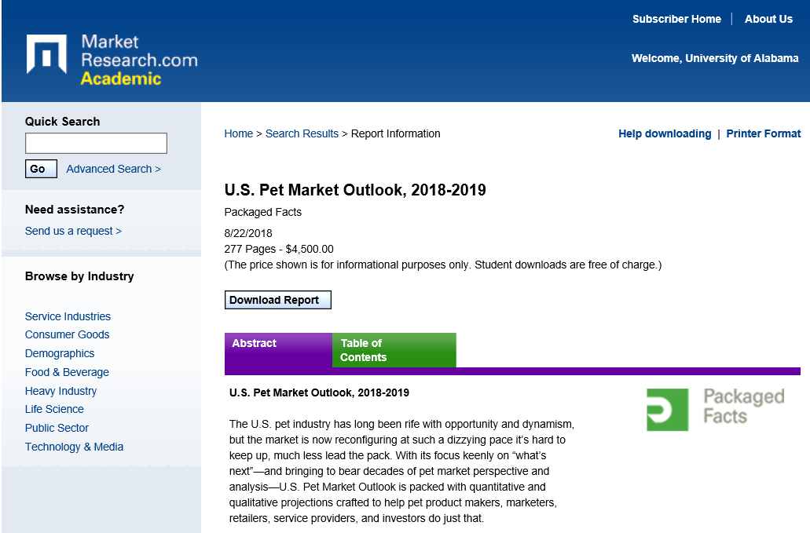

Slide 75
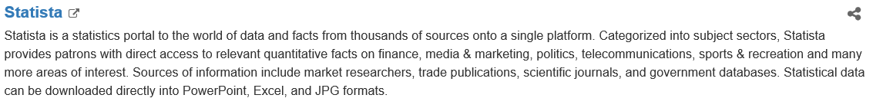


Slide 76

From Statistica …

Slide 77

Also in the UA Library

Slide 78

Sport Statistics

Slide 79

Association Information

Slide 80

Over 23,000 Associations

Slide 81

Along with the details

Slide 82
Secondary Information
Three basic types of secondary information we can find:
Market structure, industry structure, economic issues, industry issues, industry trends, social trends, industry drivers, characteristics of markets
Numbers, performance, locations, types of businesses (and other economic entities)
Numbers, behaviors, locations, types of people

Slide 83
The basic source for business counts and industry figures (unbiased and accurate) is the 5 year Census

Slide 84

Census Web Page

Slide 85

Business Data from the Census

Slide 86
NAICS codes for manufacturing

Slide 87

NAICS codes for retailing

Slide 88

NAICS codes for retailing II

Slide 89
Problems with government data
No names or sensitive company info disclosed
Some information is not reported because it will reveal too much
Time intervals for revenue-related data collection are lengthy

Slide 90

The downside of Census Data

Slide 91

Government Census Updates

Slide 92

County Business Patterns

Slide 93

But … the Govt. websites are a pain

Slide 94
So …
Private companies have taken over much of the between-census estimation of things

Slide 95

Dunn & Bradstreet (Hoovers)

Slide 96

Reference Solutions
Source:
Starts with Yellow Pages

Slide 97


Slide 98

Downloads to Excel

Slide 99
Ad$pender

Slide 100
Secondary Information
Three basic types of secondary information we can find:
Market structure, industry structure, economic issues, industry issues, industry trends, social trends, industry drivers, characteristics of markets
Numbers, performance, locations, types of businesses (and other economic entities)
Numbers, behaviors, locations, types of people

Slide 101
People data
Numbers of people
Numbers of people where
Nation, state, county, tract, zip, block group, block, radius, trade area
Numbers of types of people
Numbers of types of people when
Past exact (?) versus now (estimated) versus forecast
Spending by people!

Slide 102

Step one - The US Census www.census.gov

Slide 103

2020 Census of Population and Housing

Slide 104

The problem with Census data

Slide 105
And we need more than just numbers and demographics by geography
We need spending estimates
We need lifestyle insights
We need product usage
We need these BY demographics

Slide 106


Slide 107

Estimating Consumer Spending by category of good/service http://www.bls.gov/cex/home.htm#data

Slide 108

http://www.bls.gov/cex/

Slide 109


Slide 110

Adding Geography

Slide 111

Tuscaloosa Block Groups (n)

Slide 112

Tuscaloosa Block Groups (s)

Slide 113
Updating Census Data
Estimates (!) of newer Census-type data are available from a variety of sources – some free, most not.
Most GIS packages include them.

Slide 114

Some are part of a larger package

Slide 115

https://claritas360.claritas.com/mybestsegments/

Slide 116

Personality Segments

Slide 117

A really good GIS:

Slide 118

My Demographics Package

Slide 119






Slide 120

Simmons Insights

Slide 121
Takeaways from Secondary Data Research
Sometimes it is all you get
Feasibility analysis
Market opportunity analysis
Sometimes it is all you need
To convince the bank / boss
To compare alternatives
Very cost effective if done right
Most times it helps you figure out what you don’t know so you can add that element later
To generate hypotheses

